Slide 1
Time Scheduling
using Graph Coloring
PRESENTER:
Malepati Haneesh - 2010030323
Mounika Kolli - 2010030384
Lahari Pydikondala - 2010030372
Rithvik - 2010030421
UNDER THE GUIDANCE OF:
Udaya Rani Gurala

Slide 2
INDEX
INDEX
Topics Covered
1. ABSTRACT
2. INTRODUCTION
3. PROBLEM STATEMENT
4. ALGORITHM
5. FLOWCHART
6. NUMERIC EXAMPLE
7. IMPLEMENTATION
8. GITHUB SETUP

Slide 3
ABSTRACT
A graph coloring is the process of assigning labels to the vertices of a graph in such a way that no two adjacent vertices have the same color. Graph coloring has many real-time application including map coloring, scheduling problem, network design etc. We choose scheduling Application as making Exam time-table is required in every educational institution. In every semester the universities are required to generate exam time - table for conducting exam.

Slide 4
INTRODUCTION
• A schedule is desirable which combines resources like teachers, subjects, students, classrooms in a way to avoid conflicts satisfying various essential and preferential constraints.
• Graph coloring is one such heuristic algorithm that can deal timetable scheduling satisfying changing requirements.
• Here we will use vertex coloring as the graph coloring for our scheduling problem.
THIS IS OUR VISON
Presentations Templates are communication tools that can be used as lectures, reports, and more.
It serves a variety of purposes, making presentations powerful tools for convincing and teaching.

Slide 5
PROBLEM STATEMENT
The presence of large number of students and large number of offered courses sometimes make it difficult to schedule the exam without having any conflict.Generating exam time table is very time consuming.
In this problem, We should also consider those students who have back papers and thus, need to reappear in some of the papers. The exam time table should avoid such conflicts, like no two or three exams for the identical student should be scheduled at the same period of time. Therefore, there is a much need of an effective and accurate timetable to the performance of any educational institute.Graph coloring is a method of assigning colors to certain elements of a graph subjected to certain constraints.

Slide 6
ALGORITHM USED:
Input: The course conflict graph G thus obtained act as the input of graph coloring
algorithm.
Output: The minimum number n of non-conflicting time-slots required to schedule
courses.
Degree sequence is the array having degree of each vertices of the input graph G.
Colors being used are stored in Used_Color array. And the chromatic number will be
the total number of elements in the Used_Color array.
Step 1: Input the conflict graph G.
Step 2: Compute degree sequence of the input conflict graph G.
Step 3: Assign color1 to the vertex vi of G having highest degree.
Step 4: Assign color1 to all the non-adjacent uncoloured vertices of vi and store
color1 into Used_Color array.

Slide 7
Step 5: Assign new color which is not previously used to the next uncoloured vertex
having next highest degree.
Step 6: Assign the same new color to all non-adjacent uncoloured vertices of the
newly colored vertex.
Step 7: Repeat step-5 and step-6 until all vertices are colored.
Step 8: Set minimum number of non-conflicting time-slots n= chromatic number of
the colored graph=total number of elements in Used_Color array.
Step 9: End

Slide 8
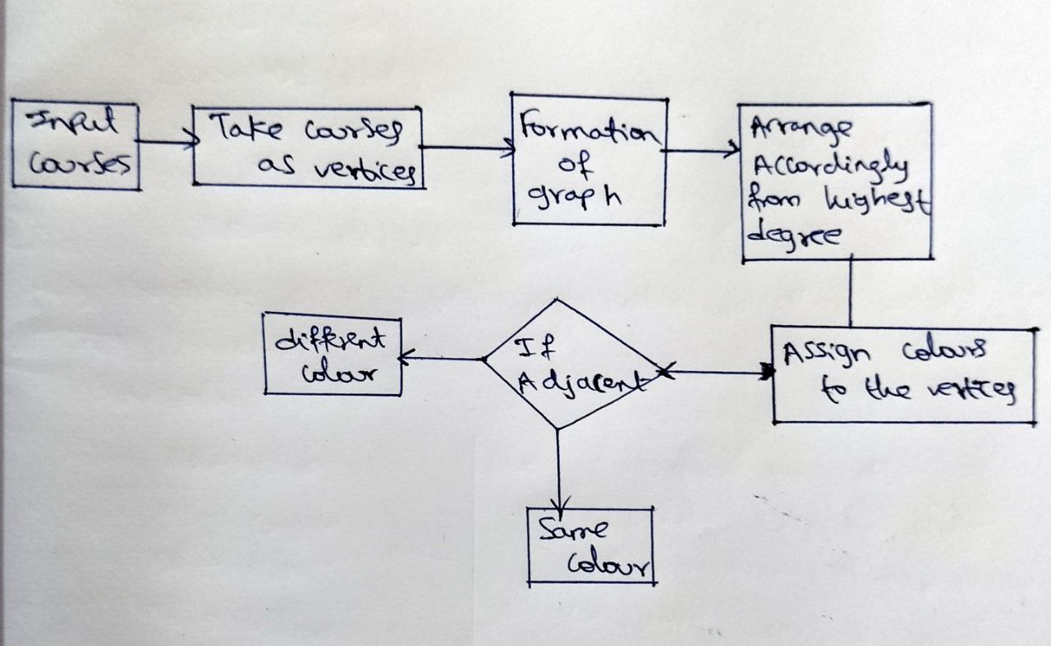
FLOWCHART

Slide 9
EXAMPLE PROBLEM
We have given the following information, with core subjects, elective subjects and arrear papers.
i)First semester subjects :Real analysis (RA), Ordinary differential equations(ODE), Graph theory(GT),Autometa theory(AT), Applied statistics(AS).
ii) Third semester subjects :Big data analysis(BA), Topology(TO), Statistical inference(SI), Fluid dynamics(FD), RA,ODE,AS. Note: RA,ODE and AS are the first semester subjects. However, we are adding the subjects in the third semester because we are assuming that some third semester students have got arrear paper in these three papers and thus need to reappear.

Slide 10
ii) Fifth semester subjects: Pesource management techniques(RMT), Mathematical methods (MA), Numerical analysis (NM).a. Note: ODE, FD are first and third semester subjets.
However, we are assuring that some fifth semester students have arrear papers in these subjects and thus need to reappear.This information given to us.We are ask to make exam time table so that no student have two or more subject exam at same time. And also ask to give total

Slide 11
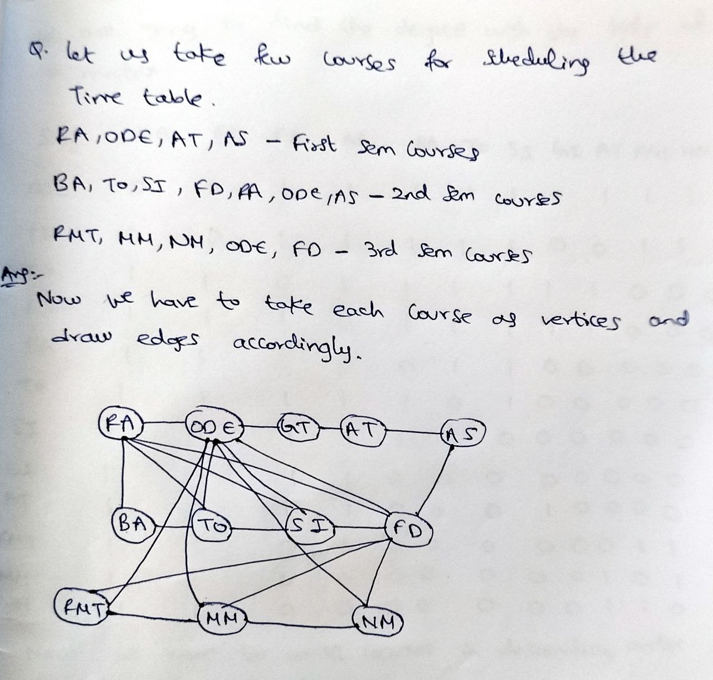

Slide 12
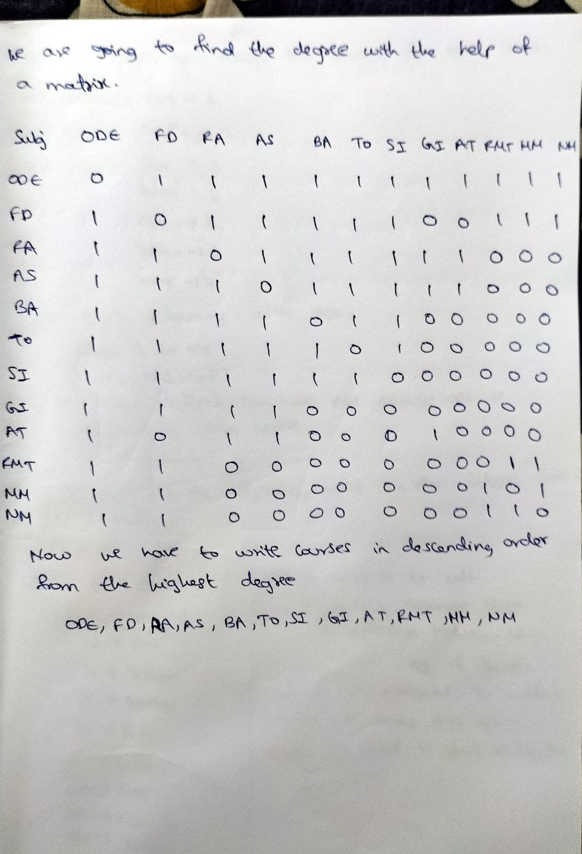

Slide 13
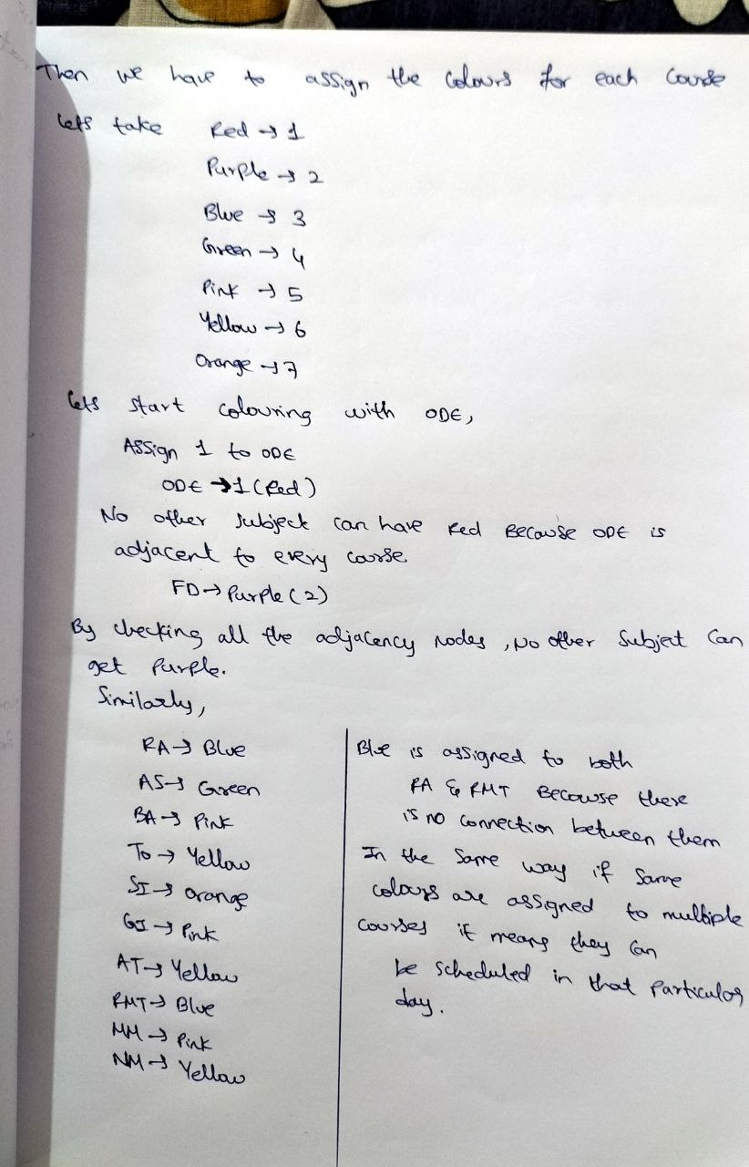

Slide 14
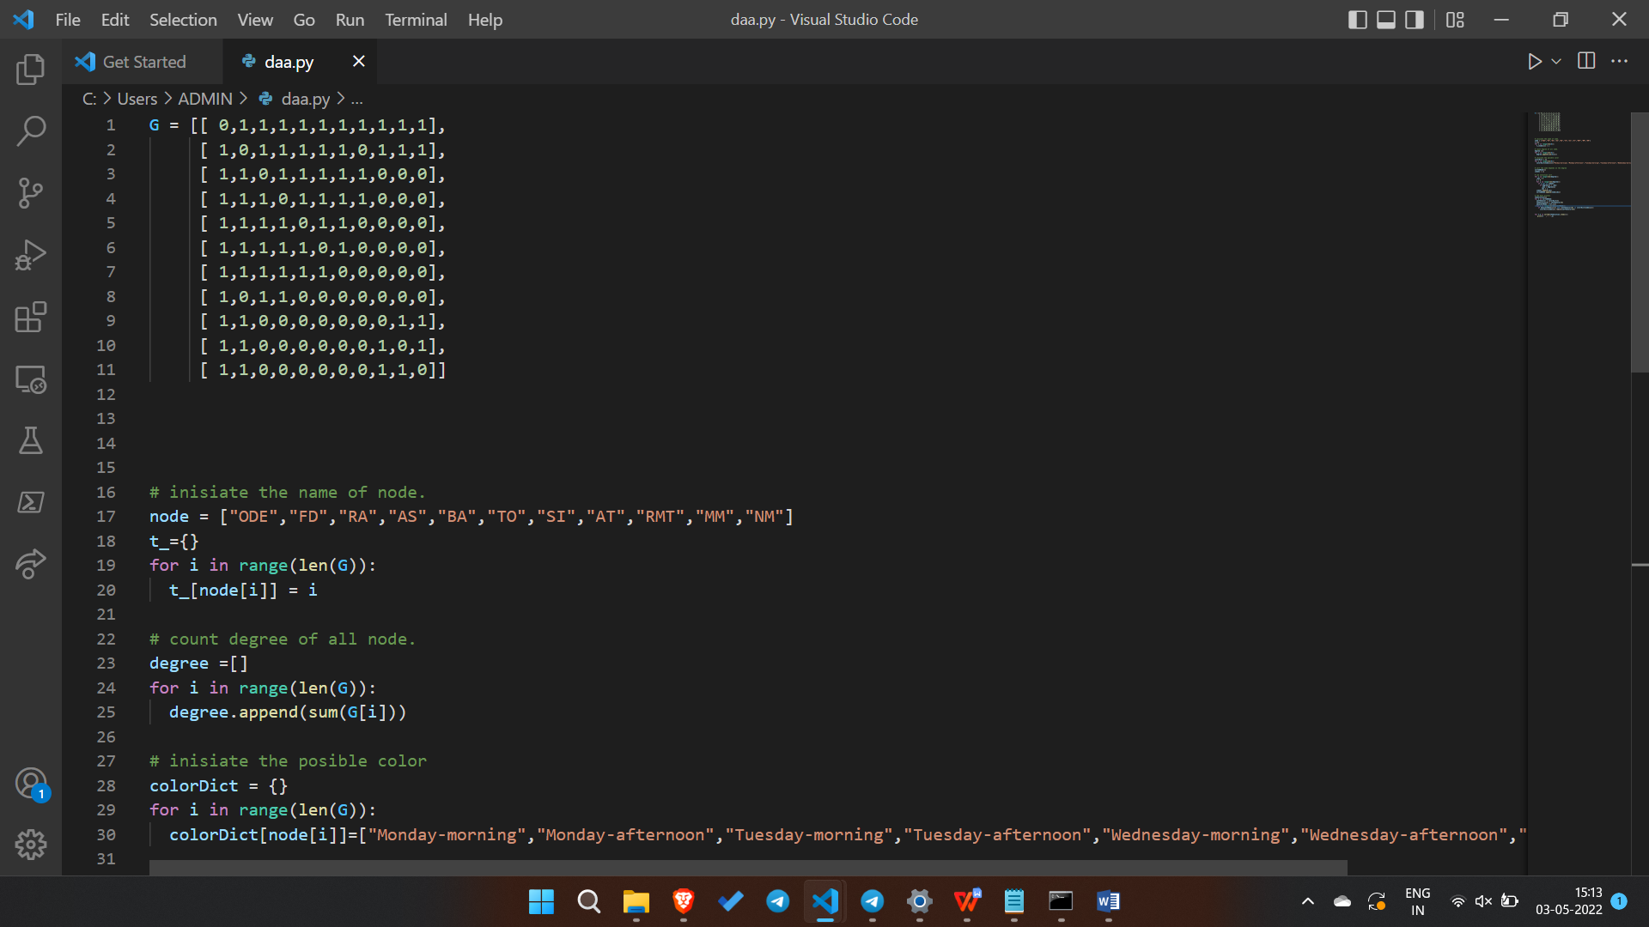
IMPLEMENTATION-

Slide 15
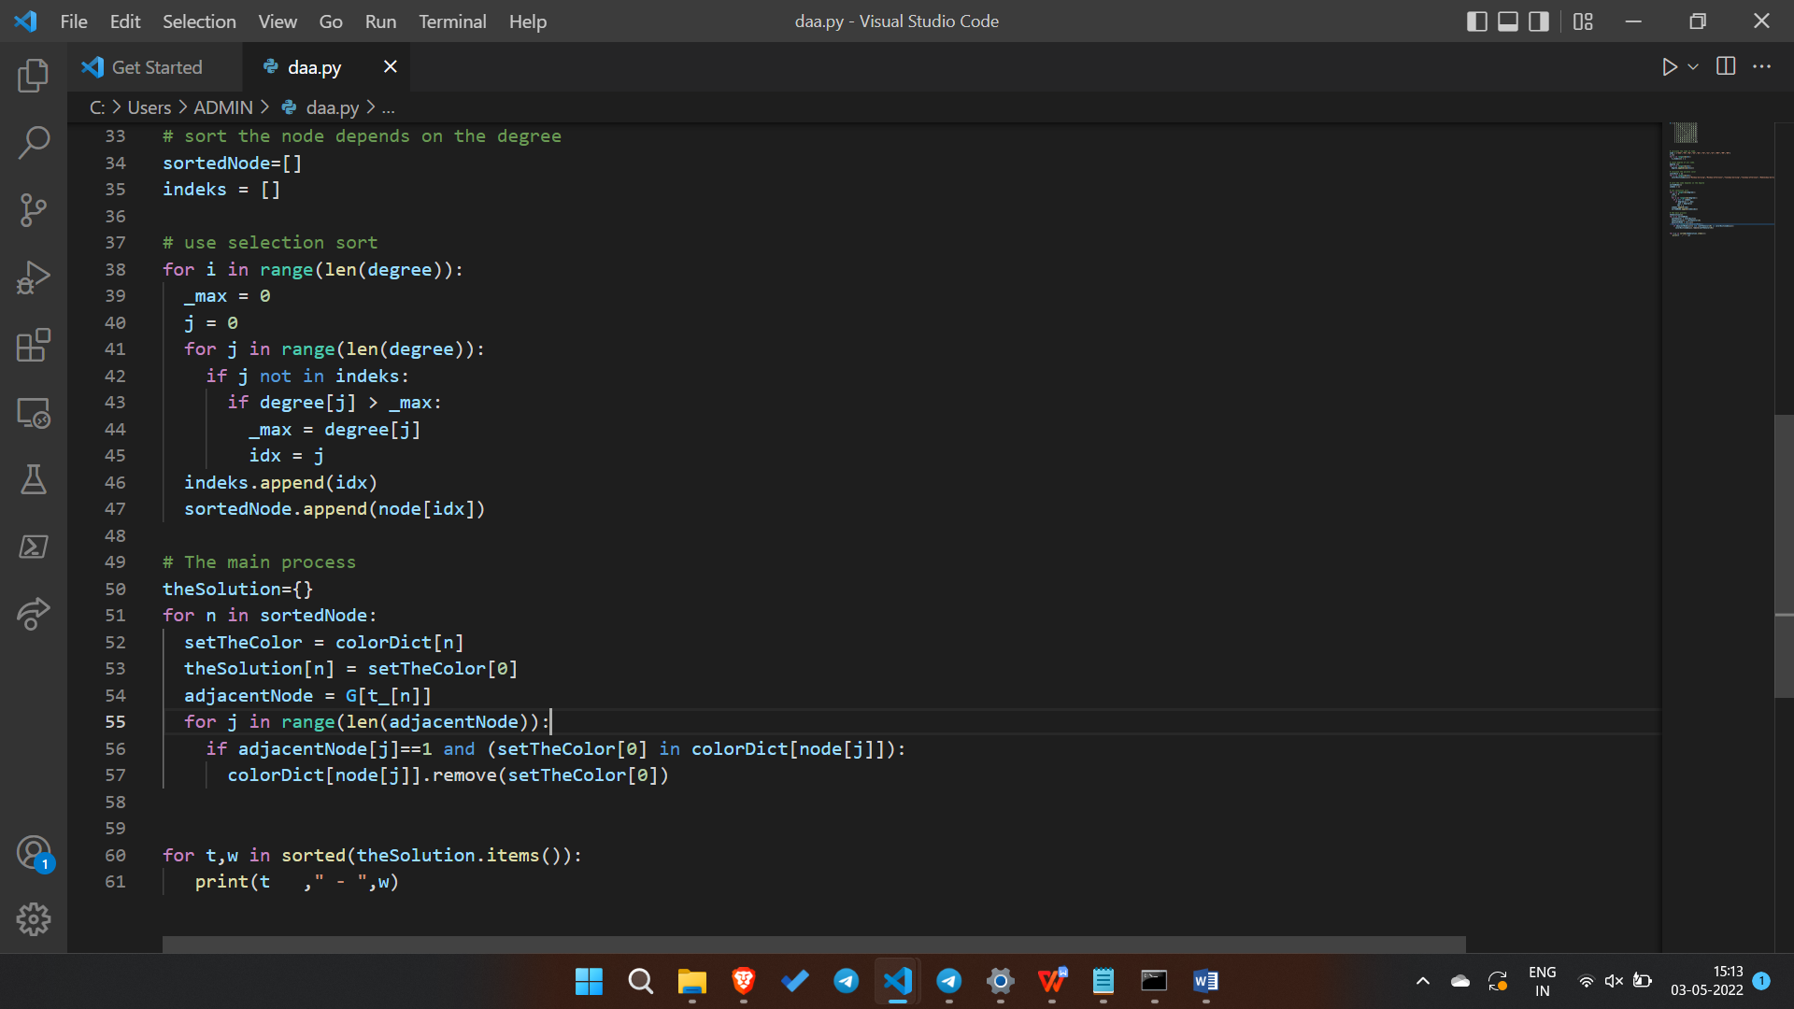

Slide 16
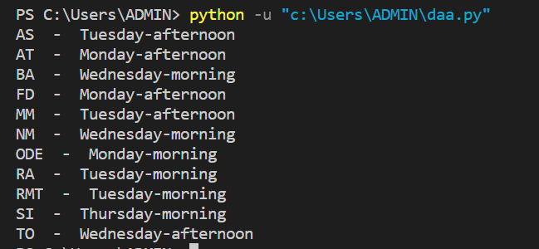
OUTPUT:

Slide 17
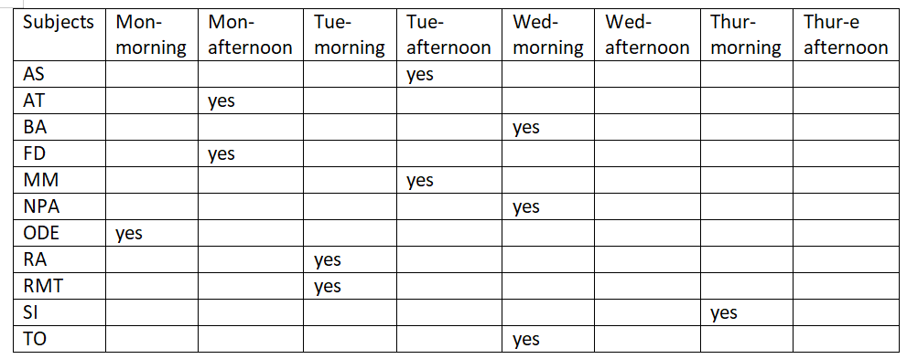
TIMETABLE:

Slide 18
SYSTEM REQUIREMENTS
HARDWARE REQUIREMENTS
RAM: 8.00 GB Processor: Intel Core 5 System-type: 64-bit OS Version: 20H2
Edition: Windows 10
SOFTWARE REQUIREMENTS
OS : Windows
Tools: VS code

Slide 19
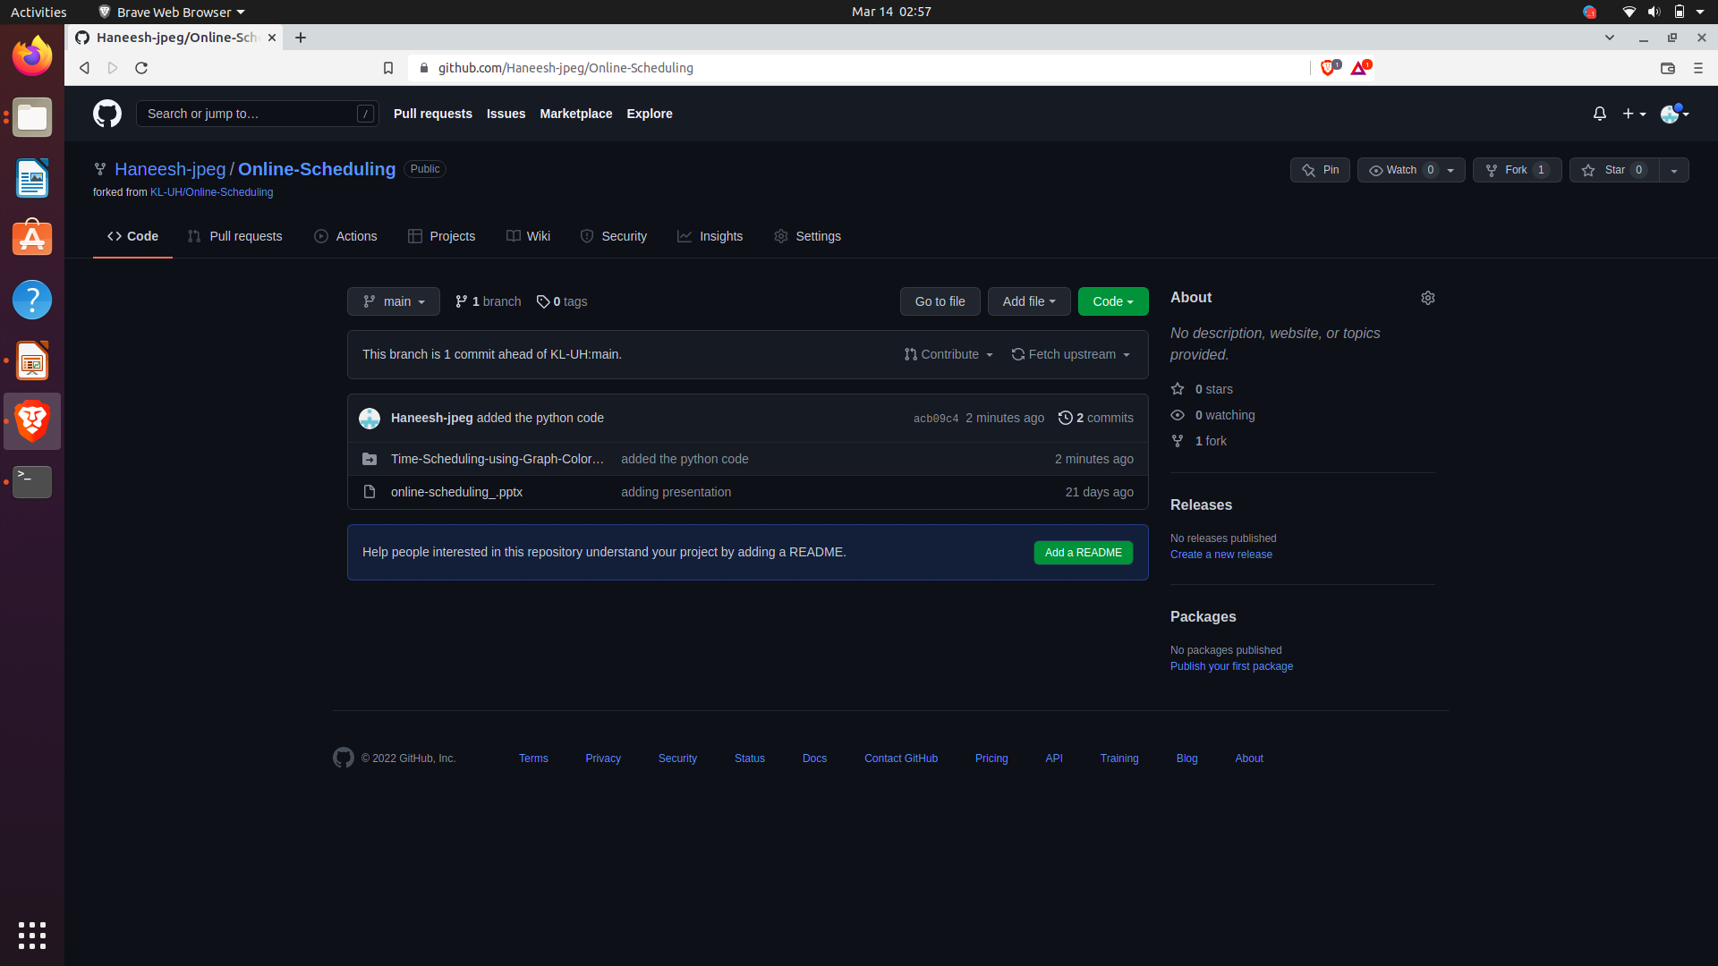
GitHub Commits :-

Slide 20
CONCLUSION:
In this paper our approach has covered many constraints in scheduling University time table. We have tested the proposed method on various kinds of course combinations. The proposed method has been shown to produce feasible results in far better running time. So our approach can give best possible results for almost every time table scheduling problems by using minimum number of slots. The complexity of a scheduling problem is directly proportional to the number of constraints involved. There is no fixed algorithm to solve this class of problem.
An algorithm which can evenly distribute resources among available time-slots without conflict, create unique and optimized schedule and satisfy all hard and maximum number of soft constraints can be called ideal. Graph Colouring is such algorithm which is surely an evolving area.

Slide 21
Thank You

